Slide 1

Jimco A/S
Fish Meal
Industrial Air

Slide 2
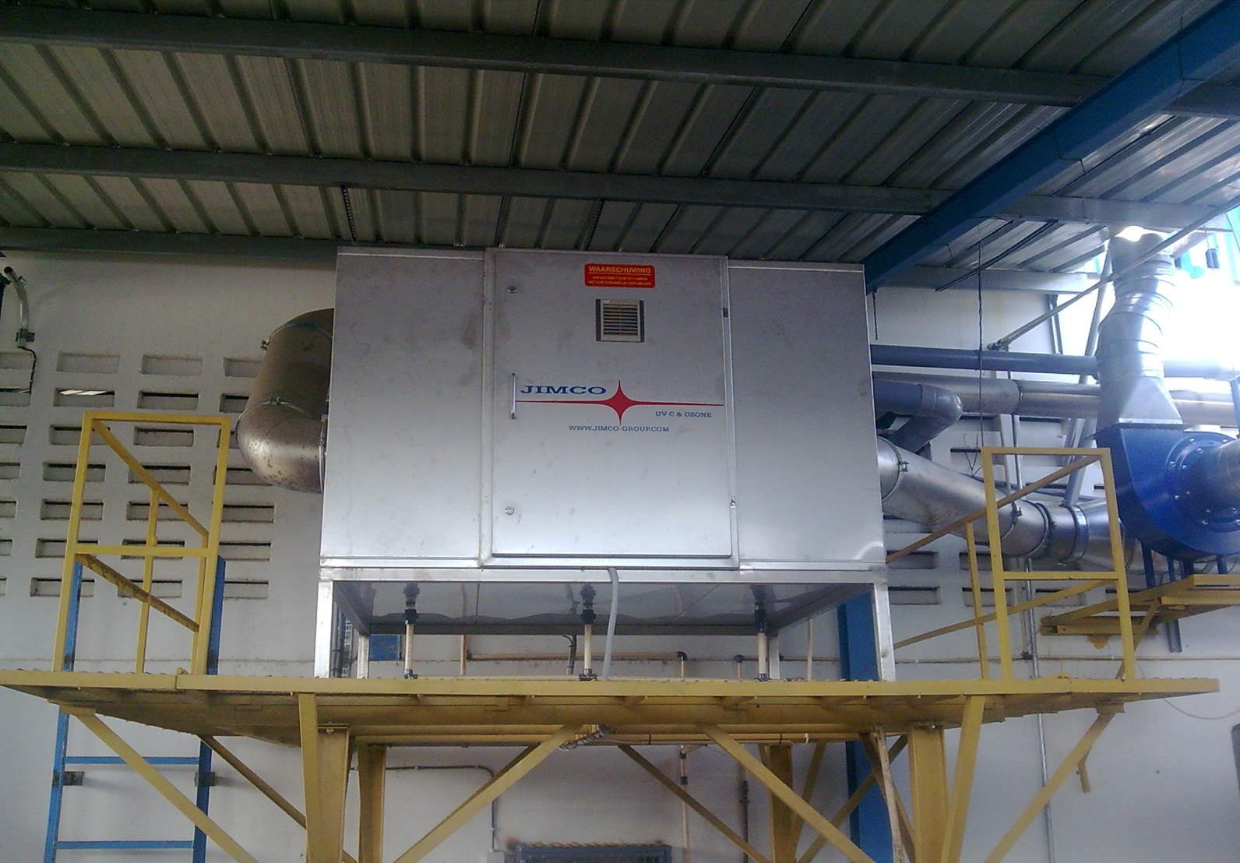
Odor treatment from
Fishmeal production

Slide 3
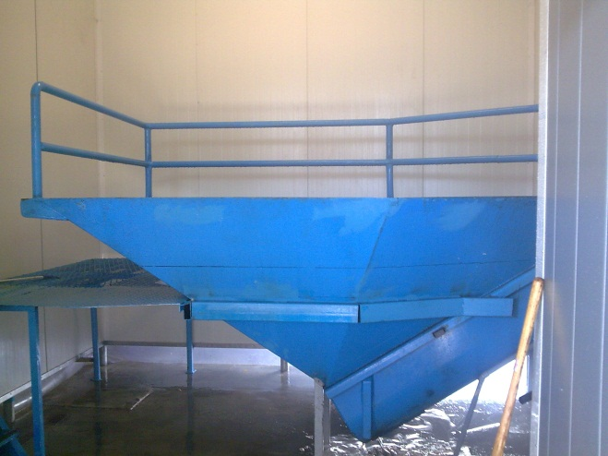
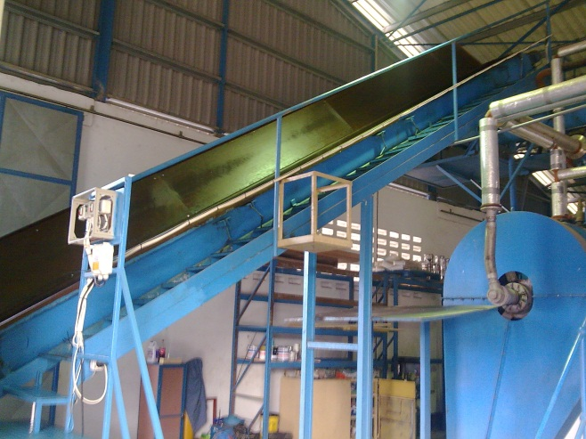
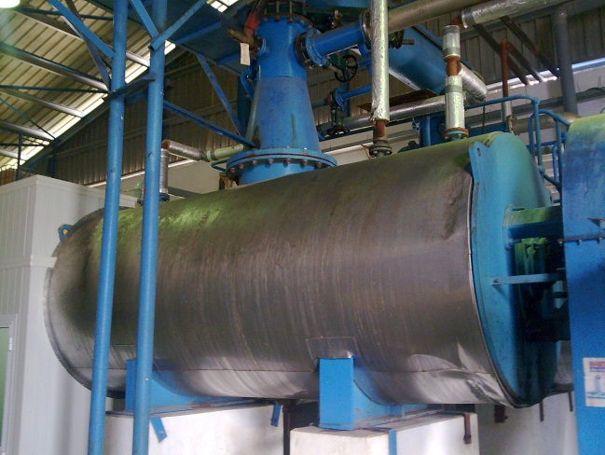
UV-C & Ozone Technology
Facts about Jimco UV-C & Ozone Technology
• Part of the cycle in nature
• Technology known since the 18th century
• Used in the industry
• No NOX (Nitric Oxide) is formed

Slide 4
How does the technology work?
4 step technology:
The contaminated hot air from the cooker passes through the condenser taking out the vapours
Now the air goes to the scrubber “working with ph below 4” for taking out the ammonia
The ammonia free air goes to the Jimco FLO-K system (Photo light oxidation)
End treatment in the catalyst
Now the air is odorless

Slide 5
How does the technology work?
• The contaminated air passes
through the system
• The Oxygen converts into Ozone
-
-
+
-
+
+
-
+
+

Slide 6
How does the technology work?
• The contaminated air passes
through the system
-
• The Oxygen converts into Ozone
-
+
• The Ozone combines with the
organic substances in the air
+
-
+
+
-
+
-
+
+
-

Slide 7
How does the technology work?
• The contaminated air passes
through the system
-
• The Oxygen converts into Ozone
-
+
• The Ozone combines with the
organic substances in the air
+
-
• The organic substances are
oxidized
+
+
-
+
-
+
+
-

Slide 8
Combustion Process:
• The lamps produce Ozone and
UV-C light
• The UV-C light destroys the protein
chains in the airflow
Having destroyed the protein chains, it is
easy to oxidize the contaminants
-
-
+
-
+
+
-
-
+
+
-
+
-
+
+
-
+
+

Slide 9
Reaction Time:
• The reaction time depends on the
shape of the ventilation ducts and
the position of the FLO-system.
• A reaction time of 2 seconds is
desirable to ensure a complete
oxidation

Slide 10

Waste Product:
• After combustion the
waste product is:.
• Water, Oxygen and CO²

Slide 11
Waste Product:
• After combustion the
waste product is:.
• Water, Oxygen and CO²
• Polymerizated grease

Slide 12
Waste Product:
• After combustion the
waste product is:.
• Water, Oxygen and CO²
• Polymerizated grease
Polymerizated grease is 100 % biodegradable

Slide 13
Advantages:
Advantages of the FLO-Technology
Inexpensive in use

Slide 14
Advantages:
Advantages of the FLO-Technology
Inexpensive in use
No grease deposits in the duct system

Slide 15
Advantages:
Advantages of the FLO-Technology
Inexpensive in use
No grease deposits in the duct system
Minimizing the fire risk

Slide 16
Advantages:
Advantages of the FLO-Technology
Inexpensive in use
No grease deposits in the duct system
Minimizing the fire risk
Up to 95% reduction of odours to the surroundings

Slide 17
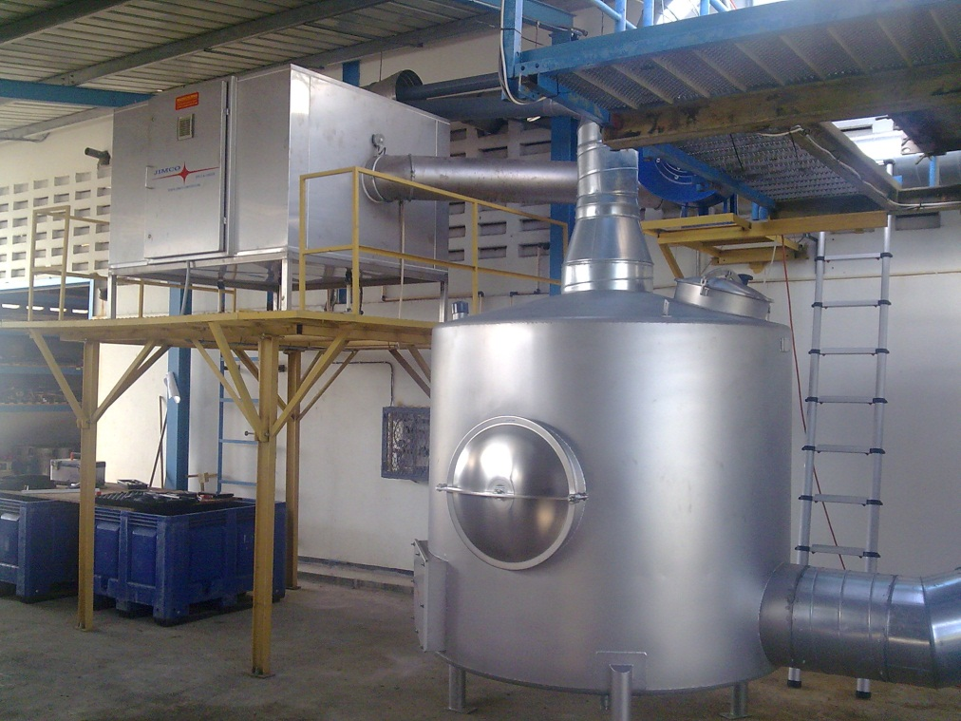
Advantages:
Advantages of the FLO-Technology
Inexpensive in use
No grease deposits in the duct system
Minimizing the fire risk
Up to 95% reduction of odours to the surroundings
Easy to install

Slide 18

Thank You

